Slide 1
Implementation I
Ed Angel
Professor of Computer Science, Electrical and Computer Engineering, and Media Arts
University of New Mexico
Angel: Interactive Computer Graphics 5E © Addison-Wesley 2009

Slide 2
Objectives
Introduce basic implementation strategies
Clipping
Scan conversion
Angel: Interactive Computer Graphics 5E © Addison-Wesley 2009

Slide 3
Overview
At end of the geometric pipeline, vertices have been assembled into primitives
Must clip out primitives that are outside the view frustum
  Algorithms based on representing primitives by lists of vertices
Must find which pixels can be affected by each primitive
  Fragment generation
  Rasterization or scan conversion
Angel: Interactive Computer Graphics 5E © Addison-Wesley 2009

Slide 4
Required Tasks
Clipping
Rasterization or scan conversion
Transformations
Some tasks deferred until fragement processing
  Hidden surface removal
  Antialiasing
Angel: Interactive Computer Graphics 5E © Addison-Wesley 2009

Slide 5
Rasterization Meta Algorithms
Consider two approaches to rendering a scene with opaque objects
For every pixel, determine which object that projects on the pixel is closest to the viewer and compute the shade of this pixel
  Ray tracing paradigm
For every object, determine which pixels it covers and shade these pixels
  Pipeline approach
  Must keep track of depths
Angel: Interactive Computer Graphics 5E © Addison-Wesley 2009

Slide 6
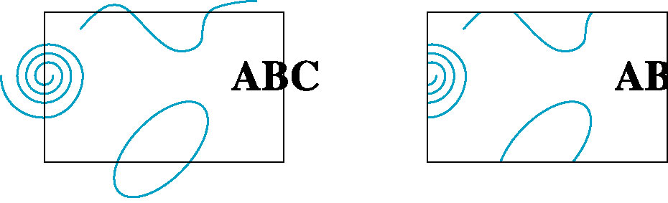
Clipping
2D against clipping window
3D against clipping volume
Easy for line segments polygons
Hard for curves and text
  Convert to lines and polygons first
Angel: Interactive Computer Graphics 5E © Addison-Wesley 2009

Slide 7
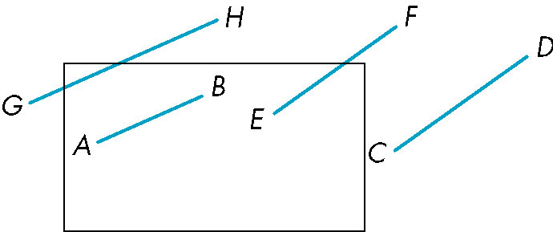
Clipping 2D Line Segments
Brute force approach: compute intersections with all sides of clipping window
  Inefficient: one division per intersection
Angel: Interactive Computer Graphics 5E © Addison-Wesley 2009

Slide 8
Cohen-Sutherland Algorithm
Idea: eliminate as many cases as possible without computing intersections
Start with four lines that determine the sides of the clipping window
y = y_{max}
x = x_{min}
x = x_{max}
y = y_{min}
Angel: Interactive Computer Graphics 5E © Addison-Wesley 2009

Slide 9
The Cases
Case 1: both endpoints of line segment inside all four lines
  Draw (accept) line segment as is
Case 2: both endpoints outside all lines and on same side of a line
  Discard (reject) the line segment
y = y_{max}
x = x_{min}
x = x_{max}
y = y_{min}
Angel: Interactive Computer Graphics 5E © Addison-Wesley 2009

Slide 10
The Cases
Case 3: One endpoint inside, one outside
  Must do at least one intersection
Case 4: Both outside
  May have part inside
  Must do at least one intersection
y = y_{max}
x = x_{min}
x = x_{max}
Angel: Interactive Computer Graphics 5E © Addison-Wesley 2009

Slide 11
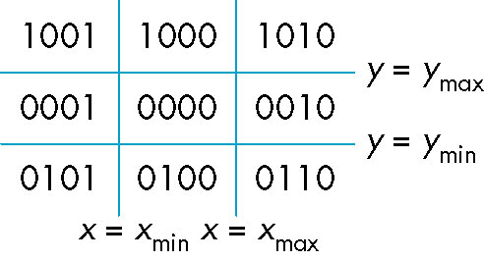
Defining Outcodes
For each endpoint, define an outcode
Outcodes divide space into 9 regions
Computation of outcode requires at most 4 subtractions
b₀b₁b₂b₃
b₀ = 1 if y > y_{max}, 0 otherwise
b₁ = 1 if y < y_{min}, 0 otherwise
b₂ = 1 if x > x_{max}, 0 otherwise
b₃ = 1 if x < x_{min}, 0 otherwise
Angel: Interactive Computer Graphics 5E © Addison-Wesley 2009

Slide 12
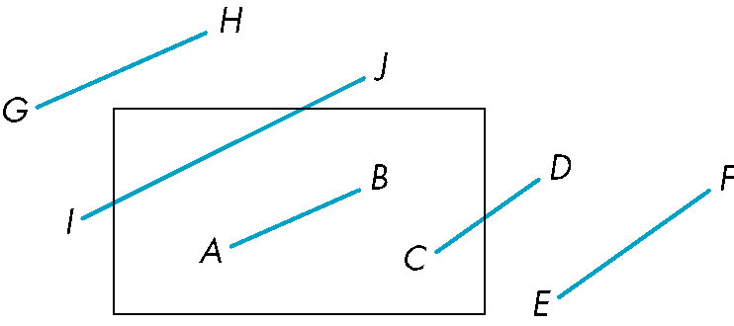
Using Outcodes
Consider the 5 cases below
AB: outcode(A) = outcode(B) = 0
  Accept line segment
Angel: Interactive Computer Graphics 5E © Addison-Wesley 2009

Slide 13
Using Outcodes
CD: outcode (C) = 0, outcode(D) ≠ 0
  Compute intersection
  Location of 1 in outcode(D) determines which edge to intersect with
  Note if there were a segment from A to a point in a region with 2 ones in outcode, we might have to do two interesections
Angel: Interactive Computer Graphics 5E © Addison-Wesley 2009

Slide 14
Using Outcodes
EF: outcode(E) logically ANDed with outcode(F) (bitwise) ≠ 0
  Both outcodes have a 1 bit in the same place
  Line segment is outside of corresponding side of clipping window
  reject
Angel: Interactive Computer Graphics 5E © Addison-Wesley 2009

Slide 15
Using Outcodes
GH and IJ: same outcodes, neither zero but logical AND yields zero
Shorten line segment by intersecting with one of sides of window
Compute outcode of intersection (new endpoint of shortened line segment)
Reexecute algorithm
Angel: Interactive Computer Graphics 5E © Addison-Wesley 2009

Slide 16
Efficiency
In many applications, the clipping window is small relative to the size of the entire data base
  Most line segments are outside one or more side of the window and can be eliminated based on their outcodes
Inefficiency when code has to be reexecuted for line segments that must be shortened in more than one step
Angel: Interactive Computer Graphics 5E © Addison-Wesley 2009

Slide 17
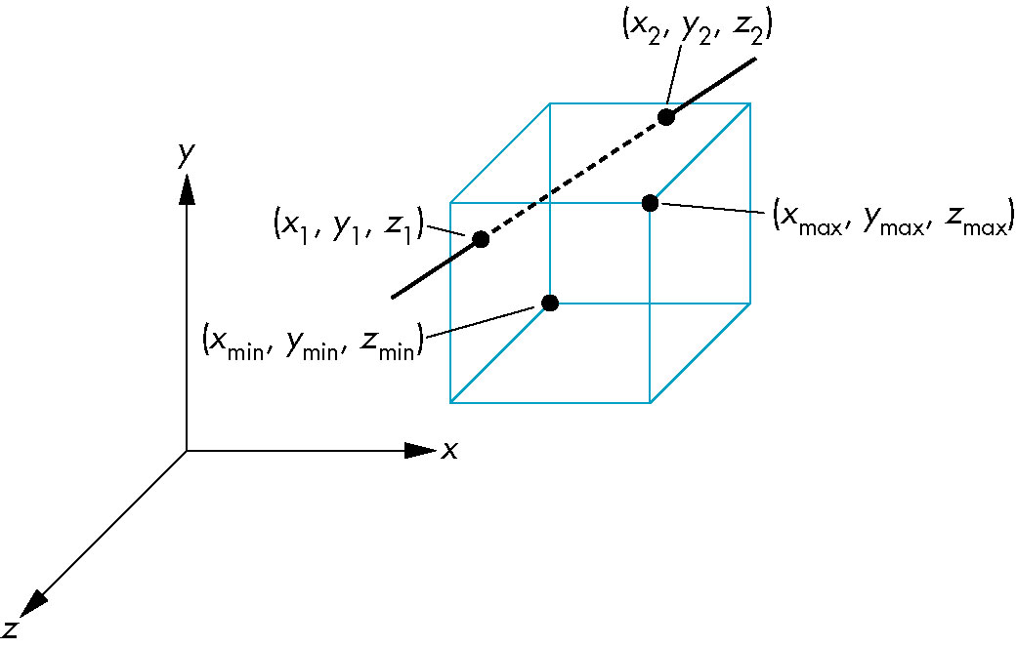
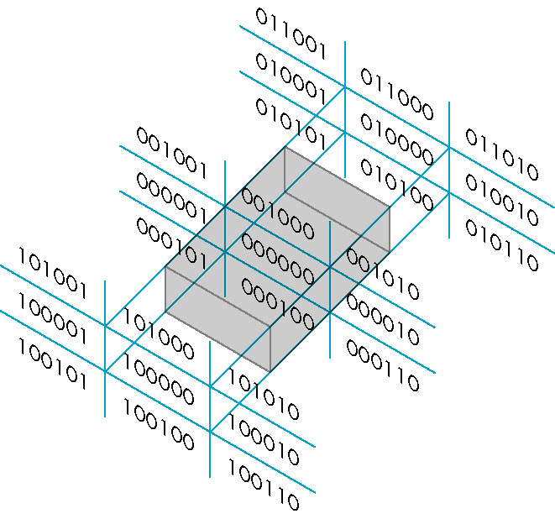
Cohen Sutherland in 3D
Use 6-bit outcodes
When needed, clip line segment against planes
Angel: Interactive Computer Graphics 5E © Addison-Wesley 2009

Slide 18
Liang-Barsky Clipping
Consider the parametric form of a line segment
We can distinguish between the cases by looking at the ordering of the values of α where the line determined by the line segment crosses the lines that determine the window
p(α) = (1-α)p₁+ αp₂ 1 ≥ α ≥ 0
p₂
p₁
Angel: Interactive Computer Graphics 5E © Addison-Wesley 2009

Slide 19
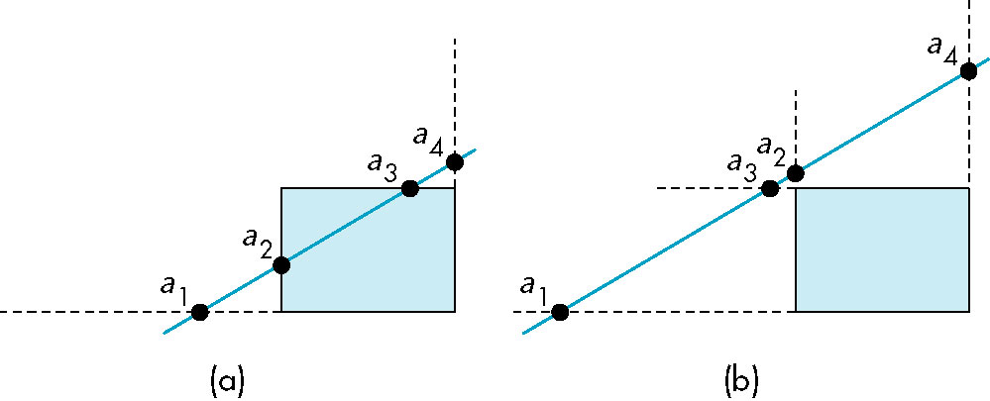
Liang-Barsky Clipping
In (a): α₄ > α₃ > α₂ > α₁
  Intersect right, top, left, bottom: shorten
In (b): α₄ > α₂ > α₃ > α₁
  Intersect right, left, top, bottom: reject
Angel: Interactive Computer Graphics 5E © Addison-Wesley 2009

Slide 20
Advantages
Can accept/reject as easily as with Cohen-Sutherland
Using values of α, we do not have to use algorithm recursively as with C-S
Extends to 3D
Angel: Interactive Computer Graphics 5E © Addison-Wesley 2009

Slide 21
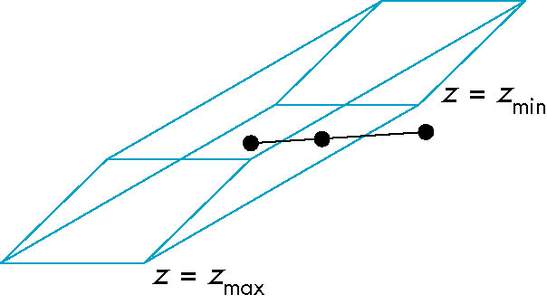
Clipping and Normalization
General clipping in 3D requires intersection of line segments against arbitrary plane
Example: oblique view
Angel: Interactive Computer Graphics 5E © Addison-Wesley 2009

Slide 22
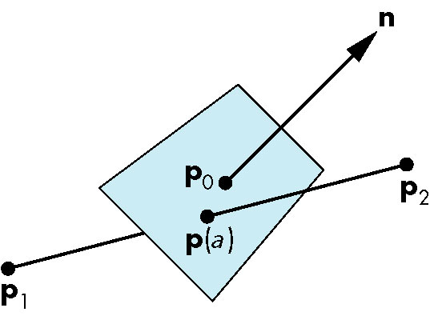
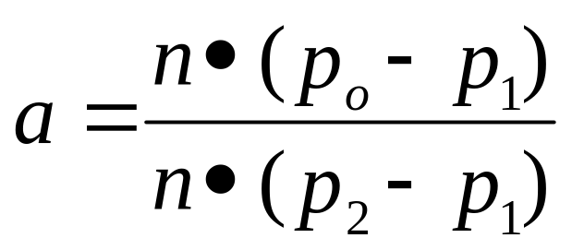
Plane-Line Intersections
Angel: Interactive Computer Graphics 5E © Addison-Wesley 2009

Slide 23
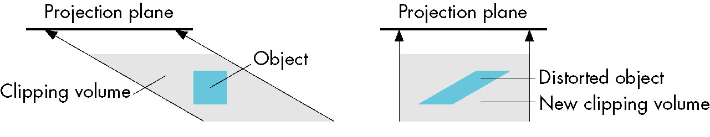
Normalized Form
top view
before normalization
after normalization
Normalization is part of viewing (pre clipping)
but after normalization, we clip against sides of
right parallelepiped
Typical intersection calculation now requires only
a floating point subtraction, e.g. is x > x_{max} ?
Angel: Interactive Computer Graphics 5E © Addison-Wesley 2009

